Slide 1


January 31, 2001
Confidential
Fuel Cell Opportunities in New Jersey

Slide 2
Agenda
Green Power Opportunities
Project Overview
Project Development
Project Management
Benefits

Slide 3
Green Power Opportunities
New Jersey has all the elements to create a fuel cell revolution in the power industry.
Projects developed by NJR and ENA
Emissions offsets required to site generation
Grid Reliability becoming an issue
Power Quality issues
Deregulation
EPA seeking more stringent emission standards
Fuel Cell Revolution
Green Power requirements
“NIMBY” sentiment makes siting traditional power plants more difficult
Growing Clean Air Commitment
State Funds to Fuel Growth

Slide 4
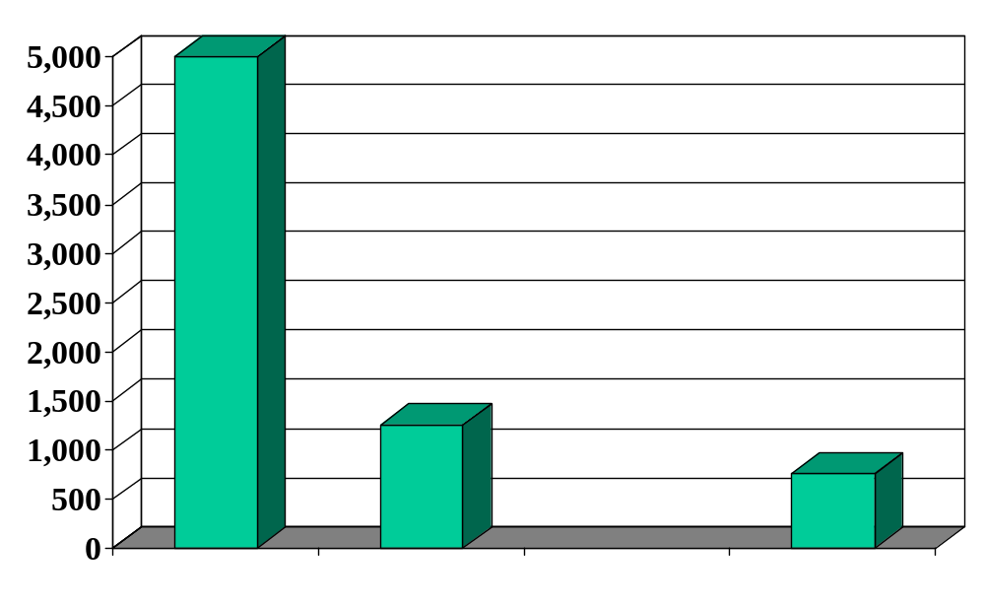
Green Power Opportunities
Current costs to manufacture fuel cells are too high to be commercially viable -- companies need large orders to automate processes to drive costs down.
Cost ($/kW Installed)
Current Fuel Cell Cost
Expected Cost Post Process Automation*
Cost of New Gas-Fired Combined-Cycle Unit
* At this installed cost, fuel cells are competitive versus combined-cycle units.

Slide 5
Renewable Energy Initiatives
New Jersey has adopted four main approaches to promoting renewable electricity development.
Renewable Electricity Standards
- Requires electric suppliers to maintain renewable resources in their supply portfolios
Renewable Electricity Funds
- Funds available for renewable energy projects, charged through System Benefit Charge on ratepayers’ bills
Net Metering
- Allows customers who self-generate to feed excess power into grid, charged on a net basis
Disclosure of Fuels and Emissions
- Label fuel sources and emissions for electricity products

Slide 6
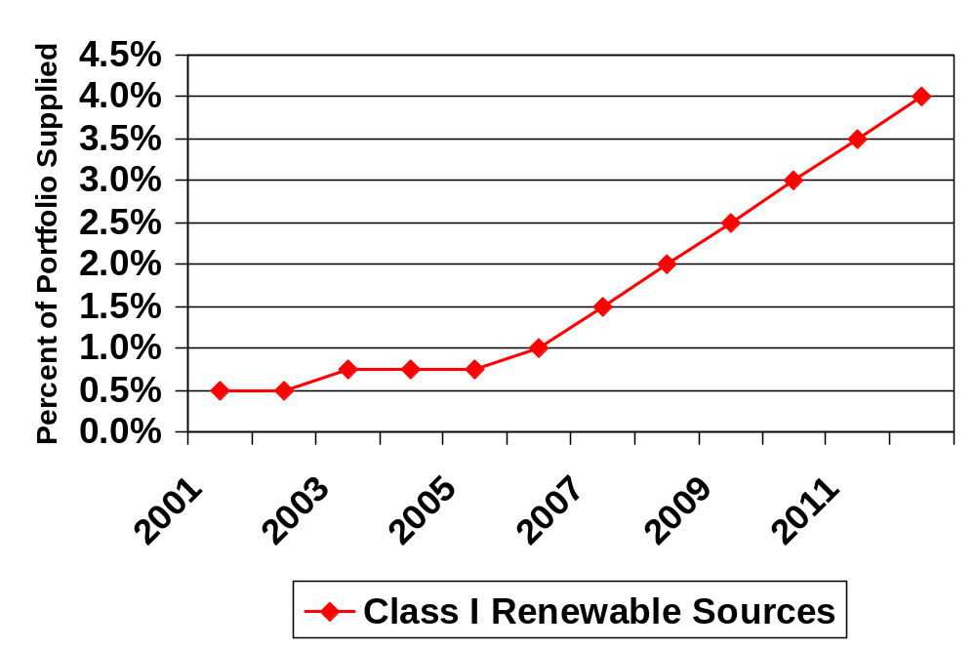
Renewable Energy Portfolio Requirements
To serve retail load, an energy supplier must have an increasing supply of Class I renewable supply in its portfolio.

Slide 7
Overview of New Jersey Renewable Energy Programs
The Board of Public Utilities has funds available for renewable energy programs that focus on Customer-Sited Clean Energy Generation and Grid-Supply Clean Energy Generation.
Customer-Sited Clean Energy
Goals and Objectives:
Promote market conditioning, development and transformation
Increase demand for clean energy projects
Lower costs for clean energy generation
Target areas of T&D system where distributed generation is most beneficial
Grid-Supply Clean Energy
Goals and Objectives:
Increase installed capacity of clean energy projects
Increase projects under development
Lower costs for clean energy generation
Increase use of clean energy grid supply as alternative to T&D upgrades

Slide 8
Project Overview
ENA is interested in forming a Clean Energy Venture (CEV) to develop fuel cell projects within the State of New Jersey. As a leading gas supplier in the state, NJR is an obvious choice to join in the venture. This venture would draw on the strengths of both companies, making these projects a reality.
NJR Strengths
Strong gas distribution system
High level of community respect
Name recognition
Regulatory expertise and relationships (state level)
Legislative relationships
Customer demographics
ENA Strengths
Power marketing expertise
Risk management products
Product development and management experience
Regulatory expertise and relationships (federal & state level)
Renewable energy expertise

Slide 9
Project Overview
ENA and its venture partner will install and dispatch a series of fuel cell farms located throughout New Jersey
Initial installations to focus on multiple MW applications (2 – 20+ MW) to enhance grid reliability and to supply green power to wholesale markets
Subsequent installations to focus on retail market (sub MW)
Installation Goal: 25 MW by 12/31/03
Farms to be owned by Clean Energy Venture
CEV to source state funds available for environmentally friendly energy resources and alternative energy projects

Slide 10
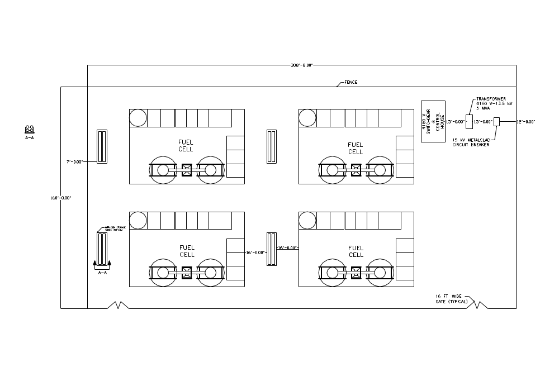
Sample Installation
FuelCell Energy
9.6 MW Site Layout

Slide 11
Target Marketplace
ENA and its venture partner will develop sites for fuel cell power plants and will target the following markets:
Larger Installations
Multiple MW
200 kW – 20+ MW
Wholesale applications and dispatch
Commercial and industrial
Dispatch into GPU grid
Increase reliability of electrical grid
Smaller Installations
Sub MW
10 kW – 250 kW
Retail applications and dispatch
State and local focus, including schools, hospitals, government buildings, etc.
Small industrial, high tech companies
Increase reliability of electrical grid

Slide 12

Project Development
Development
Services
Fuel Cell Manufacturers
Venture Partner
Construction
Services
+
Engineering
Services

Slide 13
Project Management
+
Venture Partner
Operations and Maintenance
Power
Supply
Gas
Supply

Slide 14
Project Benefits
NJR increases gas throughput
– 2 MW fuel cell installation equals approx. 375 mmBtu/day
– Baseload dispatch expected
Growth potential in the electric market
– First mover advantage as fuel cells become mainstream generation as capital costs drop
Commercialization of fuel cells is achieved
New Jersey becomes the leader in fuel cell applications
Become natural supplier of “New Economy” loads due to reliability and quality of power produced by fuel cells

